Slide 1
超越学科界限的认知基础 Transdisciplinary Cognitive Foundation Review the Basics Week 13
Ben Koo
December 7, 2020

Slide 2
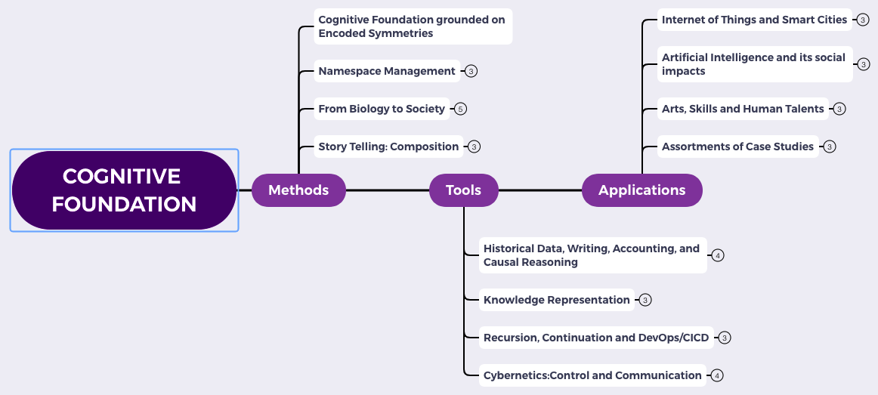
Content Themes for the semester
Overview
Namespace Management
Biology, Physics, Math, Code is Law, and Society
Story Telling, Functions/Metaphors/Analogies
Writing, Accounting, Historical Data and Temporal Reasoning
Knowledge Representation in Wiki and Files
Recursion and Continuation (DevOps/CICD)
Midterm Reports by Students
Cybernetics (Control and Communication)
Smart City and Internet of Things
Artificial Intelligence and its Social Impacts
Arts/Skills/Human Talents in the Digital Era
Student proposed Application Topics
Rehearsal
Final Reports and Celebration

Slide 3

Logic Model
Logic Model
Output: Some written strategy, in Logic Model format, for your final paper
Process: Construct an outline of your paper, that touches on Soundness and Completeness.
Input:
Present a theory that is “sound”.
Present a meaningful case study, that fits your theory
Showing that it is Sound and Complete
Context: We are at the last stretch of the semester. Students have to show whether they digested the materials presented so far.
Goal: Become aware of a System of Transdisciplinary Performance Metric.
Criteria:
Soundness: Once proved by your theory, it is valid.
Completeness: Once known valid, it can be proved.
A well-defined set of Actions and iterative Branching Strategies
A Roadmap of composable activities
Sequencing and timing conditions
Explicitly state dependencies and resource requirements
Boundary Conditions: audience must have sufficient experience in Logic Model.

Slide 4
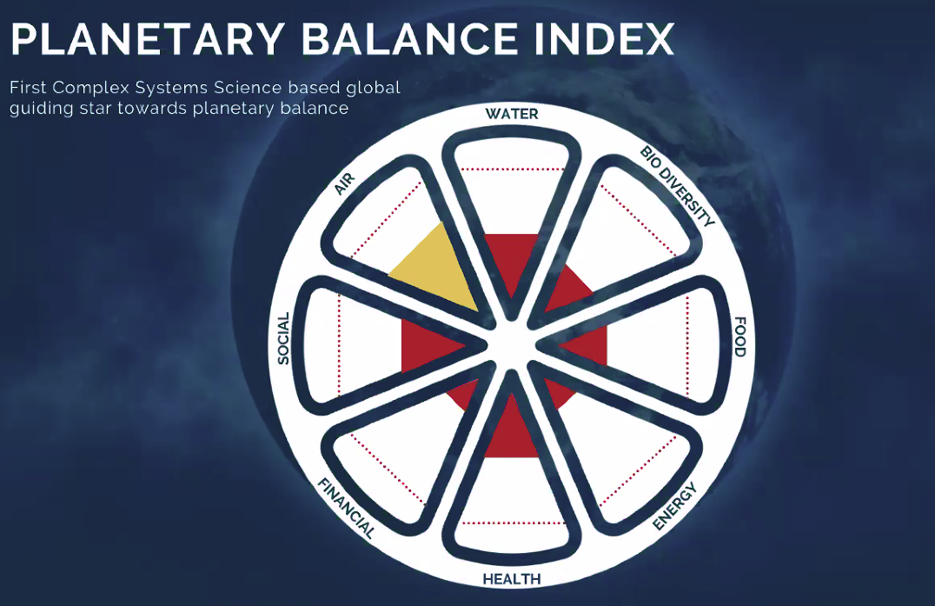
What I learned this weekend?
A possible candidate for “Enlightened” metrics

Slide 5
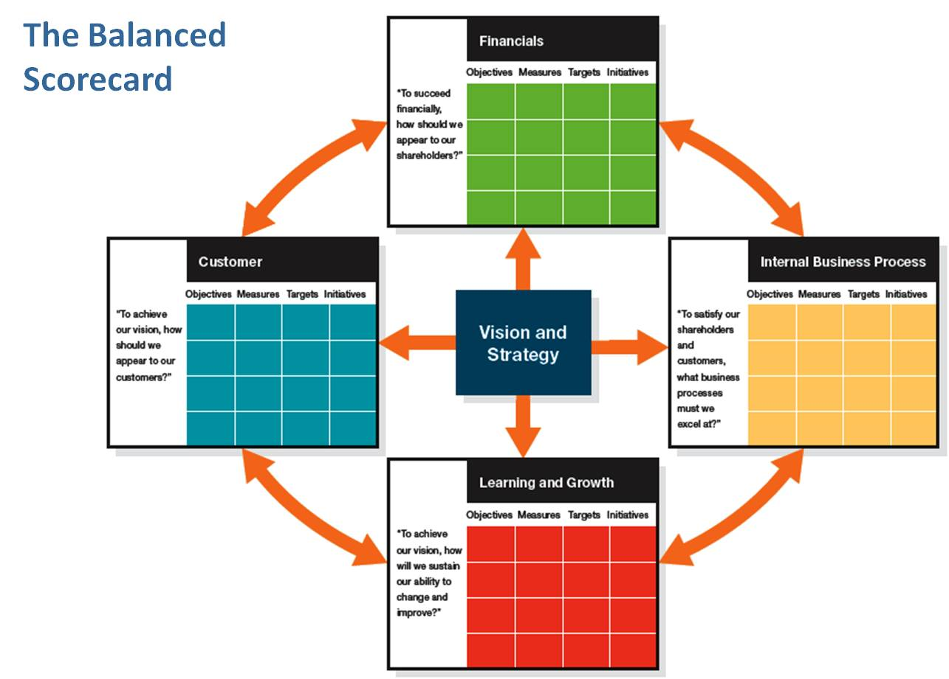
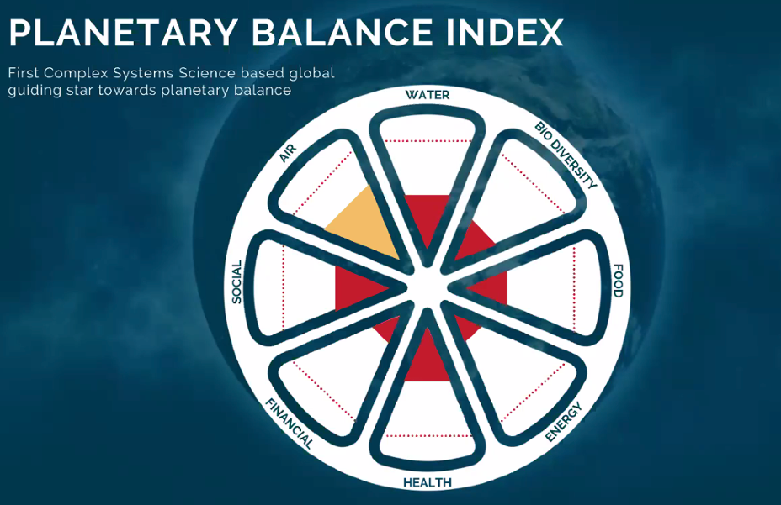
What makes a metric system “sound and complete”?
The BSC pioneered by
Robert Kaplan and David Norton
How to know whether this metric system
Is or Isn’t Sound and Complete?
Image source: by Suleiman Shehu

Slide 6
Mapping from 8 to 4 measurement components
How to know whether this metric system
Is or Isn’t Sound and Complete?
Image source: by Suleiman Shehu

Slide 7

Rearranging the metrics into a Lattice/Poset
Initial (Energy)
Financial
Food
Air
Health
Water
Internal Social
External Social
Bio Diversity

Slide 8
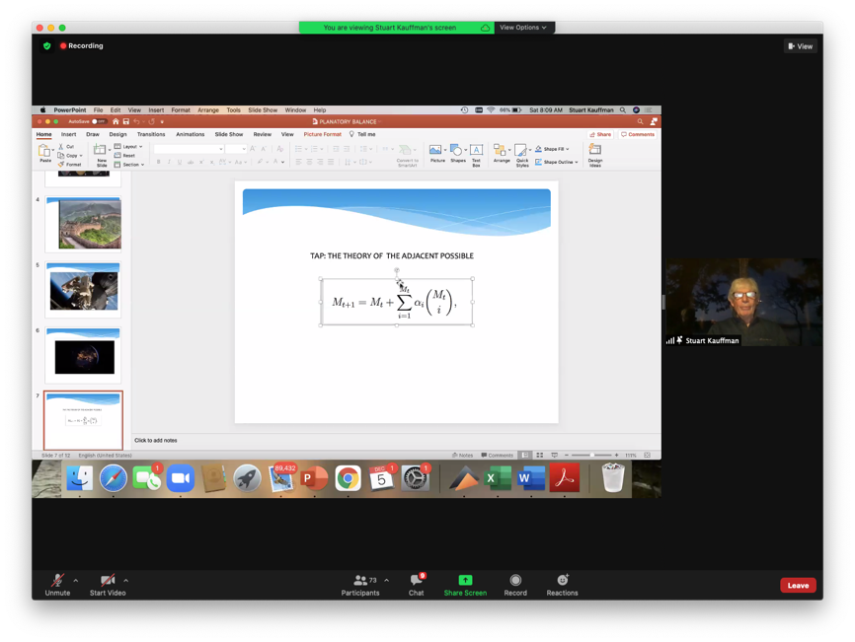
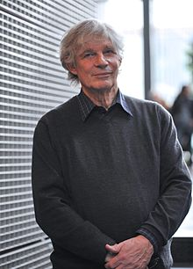
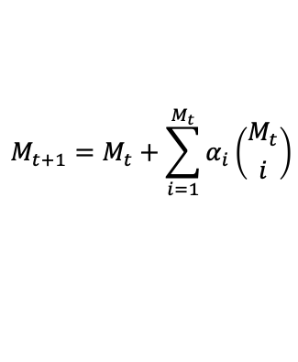
A Unifying Formula by Stuart Kauffman
$$M_{t+1}=M_{t}+\sum_{i=1}^{M_{t}}{α_{i}\left({M_{t} \atop i}\right)}$$
The Theory of the Adjacent Possible

Slide 9
We live in a Smart World,
Driven by Physically Meaningful Data
Image credits: http://verses.io

Slide 10

What if a Unifying Foundation doesn’t exist?
What if there are many Cognitive Foundations?
It is like admitting there exists some completely exotic species…

Slide 11
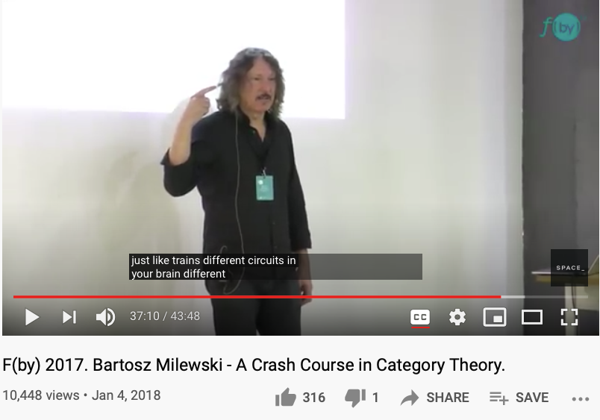
What if a there is a secrete way to attain cognitive Universality?
It is like admitting there exists some completely exotic species…

Slide 12
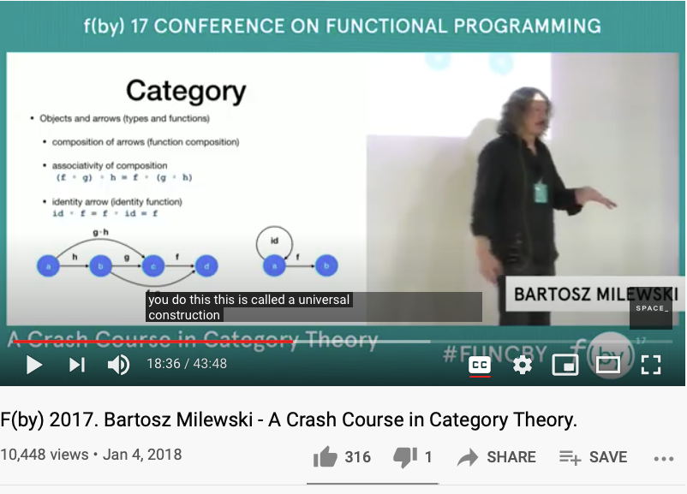
A Quick Review of Universal Objects in Category Theory
https://youtu.be/iJ7V1KXJpsE?t=1116

Slide 13

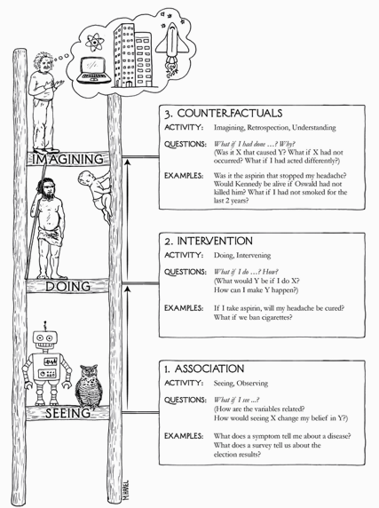
The Three Stages of the Cognitive Ladder
Why/Counterfactuals
Learning comes from What if assumptions…
How/Intervention
perform action under “Free” will
What/Association
the common observables

Slide 14
How big is the size of What If possibilities?
How/Intervention (a methodical way to intervene complexity)
Most of the operational what-if possibility spaces are rather small, so that people can deal with them with their “natural” talents…
Big Data (Software Industry) and AI brings complexity to an operational level, small code changes could result in major consequences in software controlled systems, which is almost everything we deal with on daily basis …
How to keep Abstraction separated from Concretization?
The Cognitive Discipline wrapped around in: Namespace Management (NsM).
What if complexity becomes overwhelming? Recursively apply NsM!

Slide 15
What foundation is universally trust-worthy?
What/Association (a unitary foundation)
Is there a generic data type/algebraic structure that is applicable to all?
Poset/Lattice/Monad (the foundational abstract data type) has concrete specification, and can be stored, and manipulated using scalable computing devices …

Slide 16
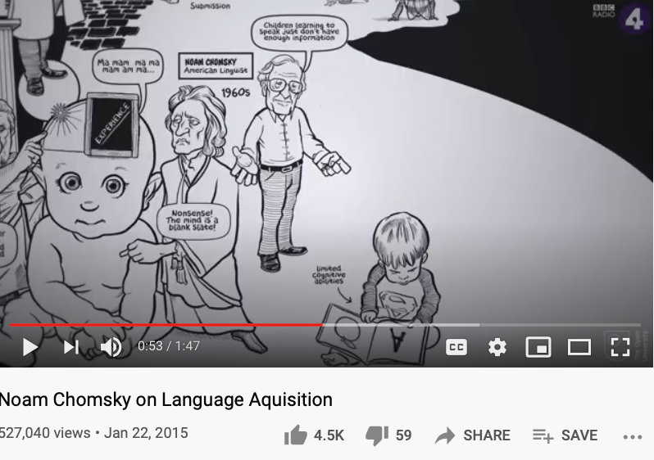
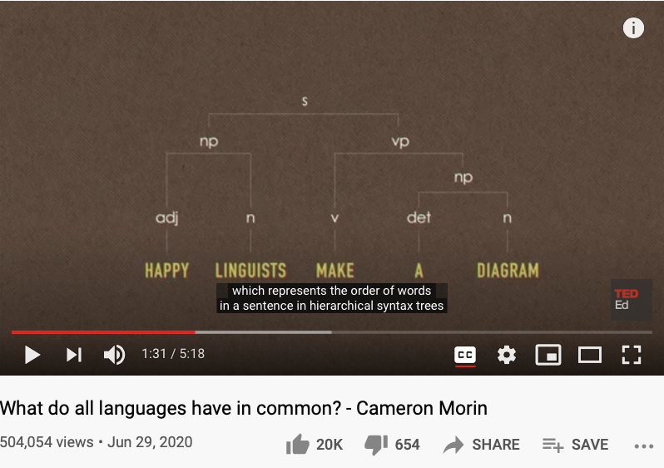
What is a “Self” ?
Is there a finite set of actions to verify the existence of self?
Is there a “universal grammar” that is applicable to all?
https://www.openculture.com/2019/02/a-brief-animated-introduction-to-noam-chomskys-linguistic-theory-narrated-by-the-x-files-gillian-anderson.html

Slide 17
Why Category Theory for Cognitive Foundation?
It is the smallest yet universal representation of concepts, so that it will fit into operational contexts when needed…

Slide 18
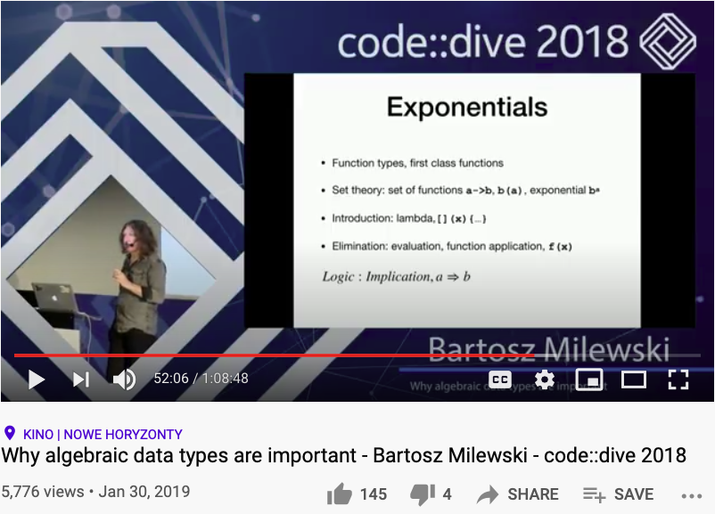
The Cognitive Connections: Linking Lambda abstraction with Arithmetic
Huawei VP Mr. Yang Shaoqing
https://youtu.be/LkqTLJK2API?t=3126

Slide 19
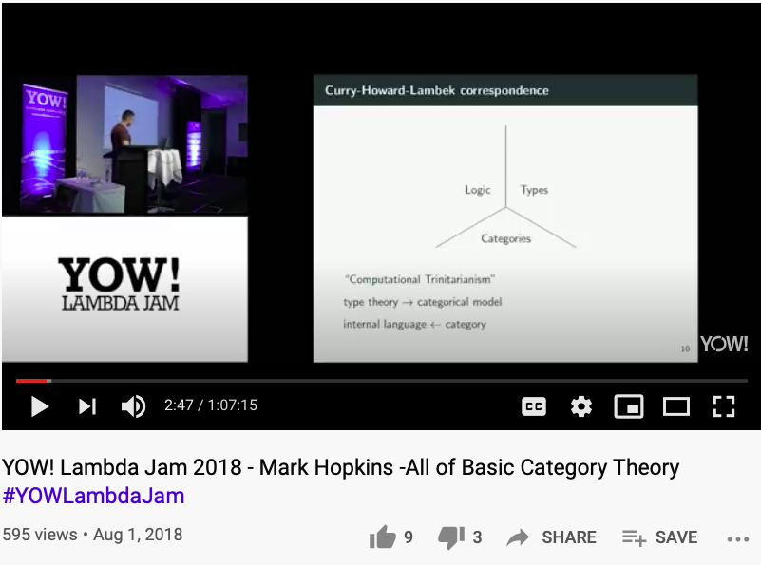
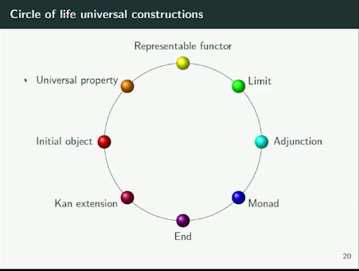
Kan Extension and other ideas in Category Theory
Huawei VP Mr. Yang Shaoqing
All these terms are equivalent…
they can be refomulated into each other…
https://youtu.be/9u1q3lH7VbE （video stops at 33:12）

Slide 20
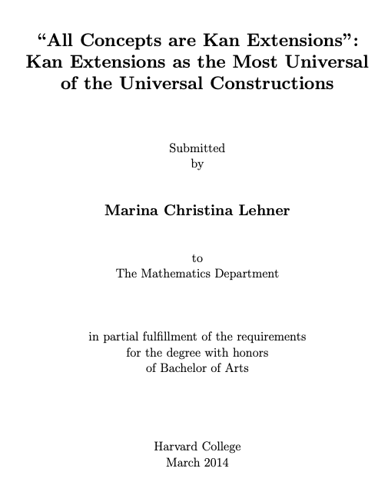
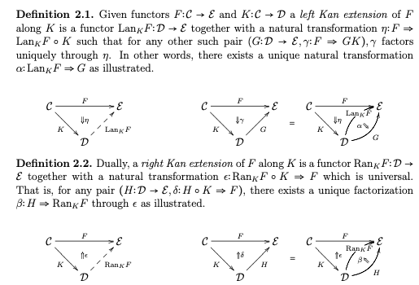
Kan Extension makes concepts Representable
Huawei VP Mr. Yang Shaoqing

Slide 21
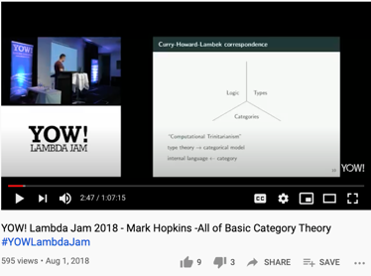
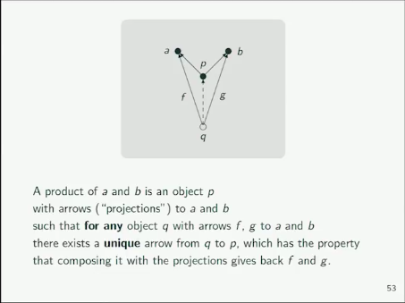
The ideas of Universality
Huawei VP Mr. Yang Shaoqing
https://youtu.be/9u1q3lH7VbE?t=962（explaination starts at 16:02）

Slide 22
What is the idea of Nature?
The Chinese phrase for Nature is: 自然！
Huawei VP Mr. Yang Shaoqing
The notion of “self” is related to the notion of
Identity morphism in Category Theory
Where the highest order of morphisms is called:
Natural Transformation

Slide 23
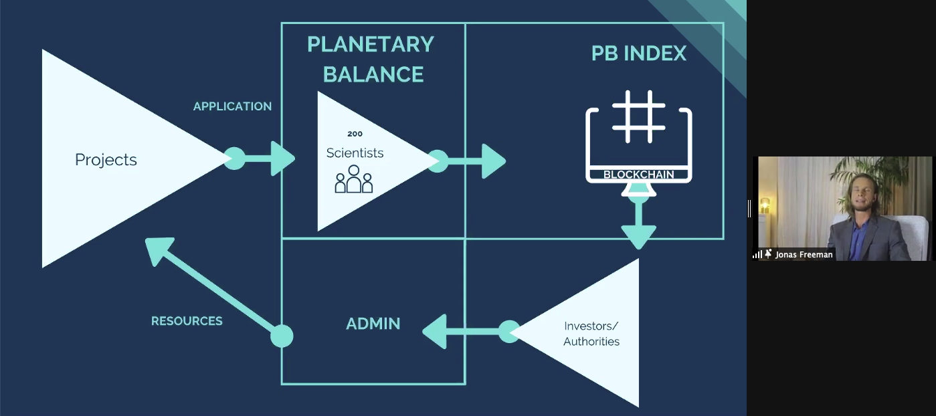
Some idea of Implementation?
Huawei VP Mr. Yang Shaoqing
Jonas Freeman,
Organizer of the 2020 Complexity Coherence Conference

Slide 24
When explaining the idea of Universal Properties …
We have explained certain aspects of all other properties in the ring.
Huawei VP Mr. Yang Shaoqing

Slide 25
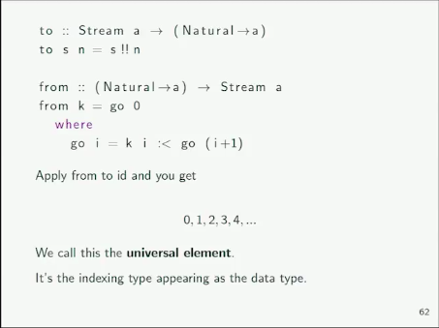
Stream as a Data Type is called the Universal Element
Huawei VP Mr. Yang Shaoqing
https://youtu.be/9u1q3lH7VbE?t=1205（explaination starts at 20:05）

Slide 26
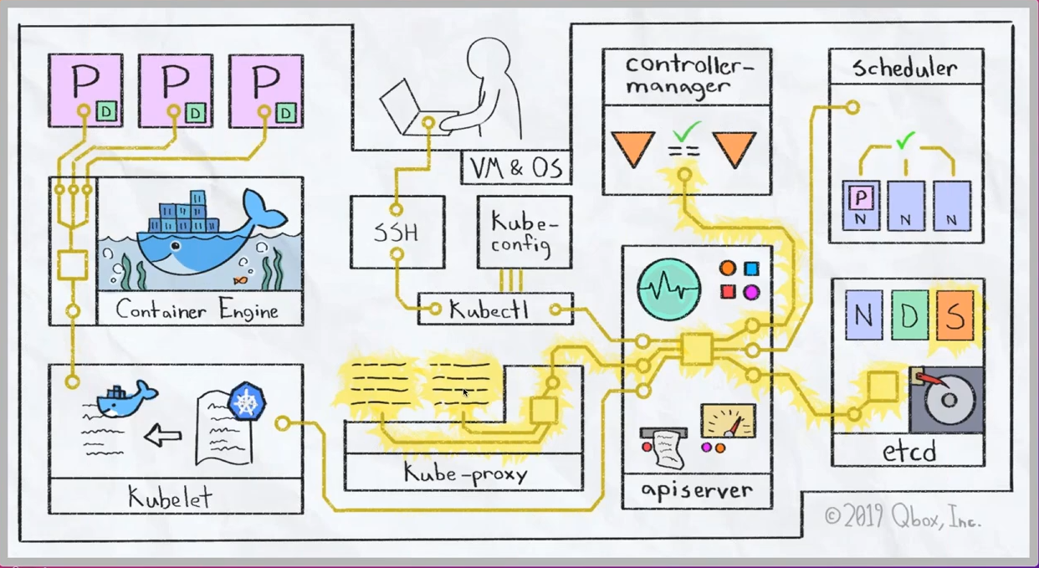
Operationalizing the Cybernetics
How to deploy a Kubernetes Cluster from Scratch (Youtube Link)

Slide 27

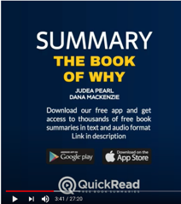
“The” Book of Why

Slide 28
What, How and Why of “operationalization”
What/Association the common observables
How/Intervention perform action under “Free” will
Why/Counterfactuals the revealing “truth” or “surprises” related to relevant spacetime contexts
When all the data are driven by one consistent (foundational) framework
A new kind (previously incommensurable) model of belief system will emerge

Slide 29
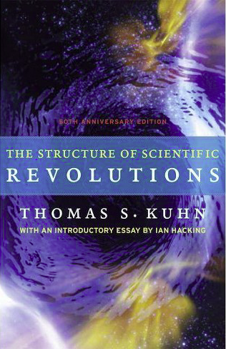

Kuhn Cycle: the evolution of a Namespace
Normal Science
Model
Drift
Model Crisis
Model Revolution
Paradigm
Change
Emerging cases or
systematic attacks
Product Development Process
in five stages
Commit
Build
Test
Stage
Deploy
Unknown/incompatible names introduces crisis. (incommensurability).

Slide 30
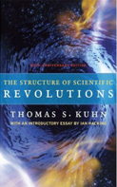

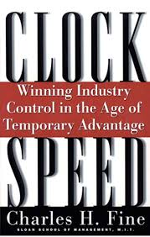




A Model of Collective Cognitive Processes
(students/teachers)
(Smart) Social Contract Execution
Traders
Miners
Coders
(Consumers/Distributors)
Three Asynchronous
Clocks in their respective
Communities
Version Upgrade
Production Code
Function Requests
Customer Crisis
Feature Revolution
Emerging cases or
systematic attacks
(Artists/Creative Projects)
(Administrators/Witnesses)
Perform Checking
receive confirmation
commit transaction
(Content Producers/Product Designers)
(Accountants/Lawyers)

Slide 31
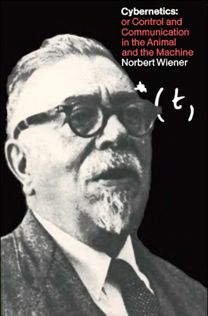
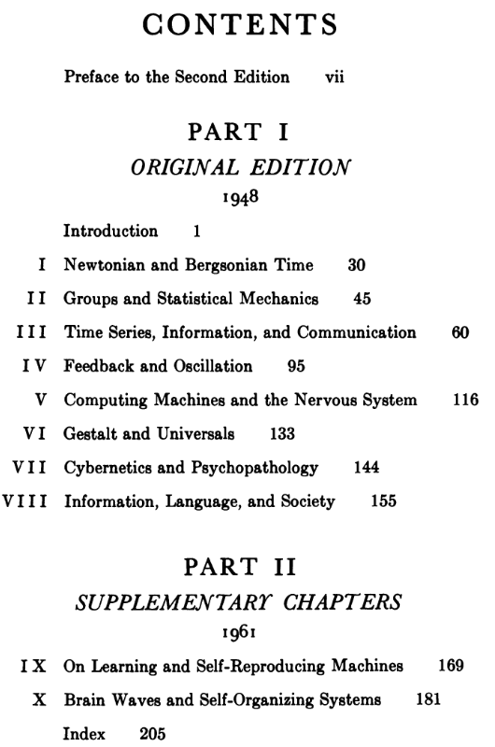
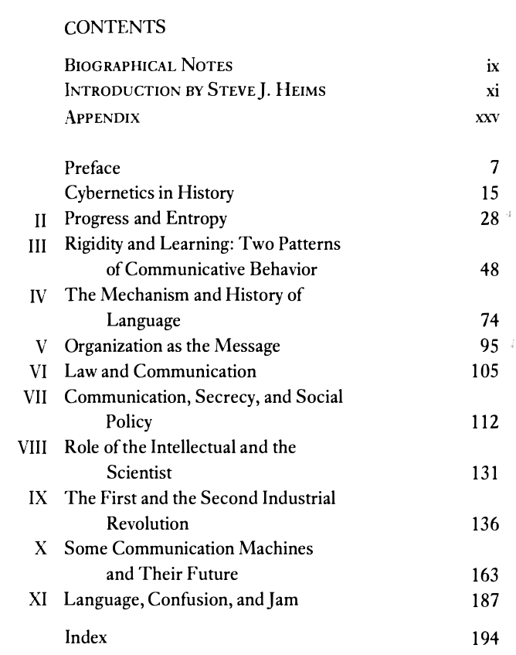
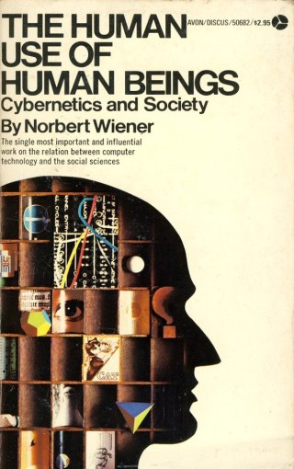
Wiener’s Framing of Societal Values

Slide 32
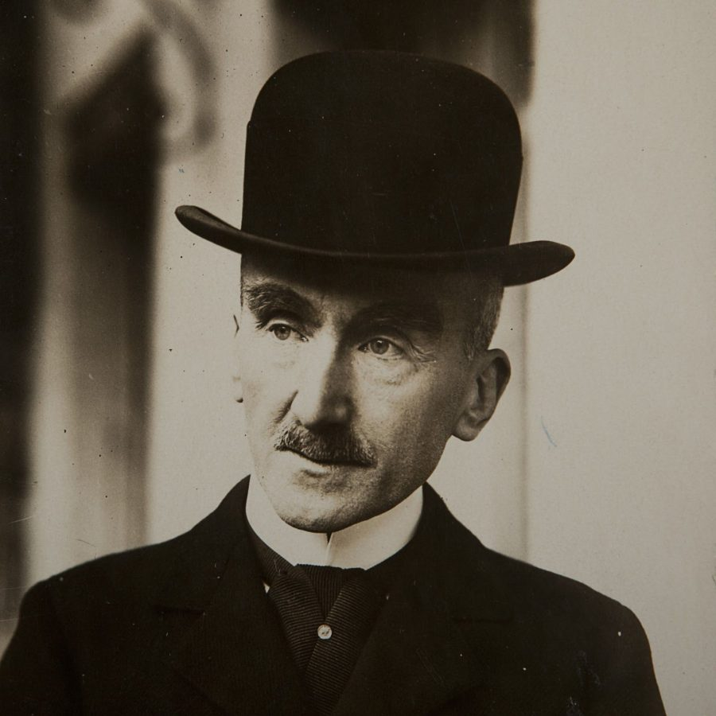
A philosopher’s definition of cognition
In An Introduction to Metaphysics (1912), Bergson expands on the central role of intuition. The true purpose of knowledge is to know things deeply, to touch the inner essence of things via a form of empathy: “A true empiricism”, he wrote, “is that which proposes to get as near to the original itself as possible, to search deeply into its life, and so, by a kind of intellectual auscultation, to feel the throbbings of its soul.”
Excerpts from: PhilosophyNow.ORG by John-Francis Phipps
Image source： dialektika.org
Henri Bergson was awarded the 1927 Nobel Prize in Literature "in recognition of his rich and vitalizing ideas and the brilliant skill with which they have been presented".^{[12]} In 1930 France awarded him its highest honour, the Grand-Croix de la Legion d'honneur.
Bergson's great popularity created a controversy in France where his views were seen as opposing the secular and scientific attitude adopted by the Republic's officials.^{[13]}
^{Content Source: Wikipedia}

Slide 33
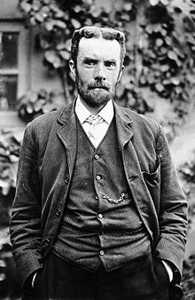
An other person mentioned extensively by Wiener
Oliver Heaviside FRS^{[1]} was an English autodidactic electrical engineer, mathematician, and physicist who brought complex numbers to circuit analysis, invented a new technique for solving differential equations, independently developed vector calculus, and rewrote Maxwell's equations in the form commonly used today. He significantly shaped the way Maxwell's equations are understood and applied in the decades following Maxwell's death. His formulation of the telegrapher's equations became commercially important during his own lifetime, after their significance went unremarked for a long while, as few others were versed at the time in his novel methodology.^{[2]}Although at odds with the scientific establishment for most of his life, Heaviside changed the face of telecommunications, mathematics, and science.^{[2]}
Text and Image source： Wikipedia.org

Slide 34
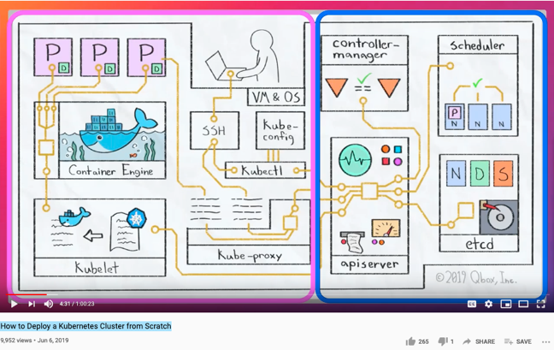
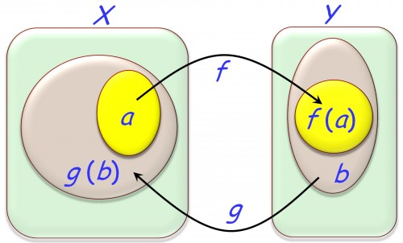
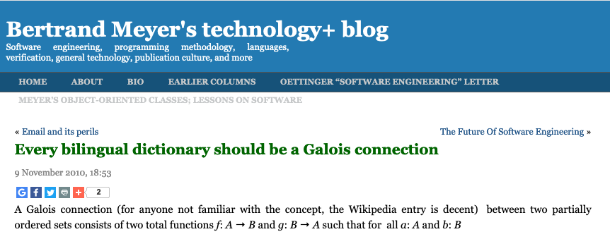
The Abstract and Concrete Domains
(f (a) ⊆ b) ⇔ (g (b) ⊇ a)

Slide 35
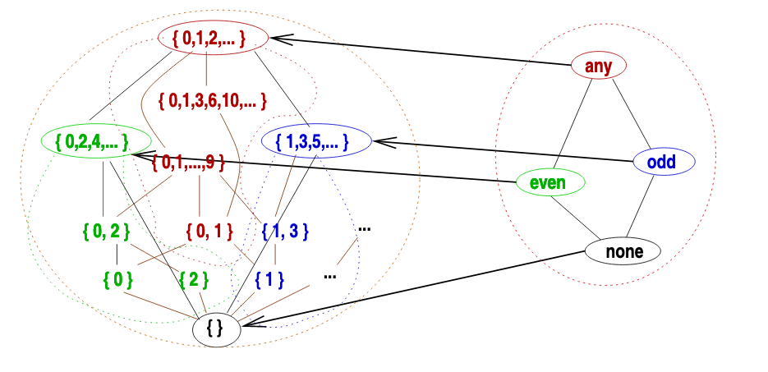
All Computation (decisions) are approximations

Slide 36
Abstraction
Concretization
Safety
Nothing
bad happens
Liveness
Some
Good Things
Must Happen
A well-defined set of Actions and iterative Branching Strategies
A Roadmap of composable activities
Sequencing and timing conditions
Explicitly state dependencies and resource requirements
Correctness

Slide 37

Abstraction
Separate Specification from Abstraction
Concretization
Why is abstraction useful?
Allow reuse through universal properties
Avoid resource conflicts
Scale free and domain neutral
Generalizing concrete experience?
Make analogies in localized contexts
Engage sensible metaphors
Define terms and boundaries
A well-defined set of Actions and iterative Branching Strategies
A Roadmap of composable activities
Sequencing and timing conditions
Explicitly state dependencies and resource requirements

Slide 38
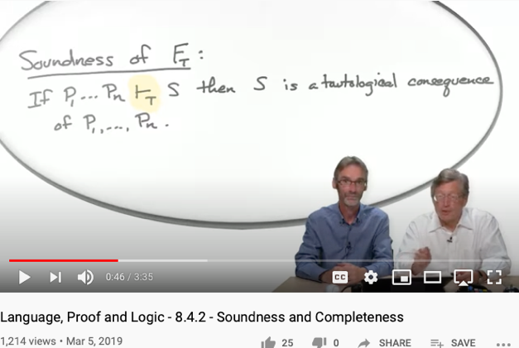
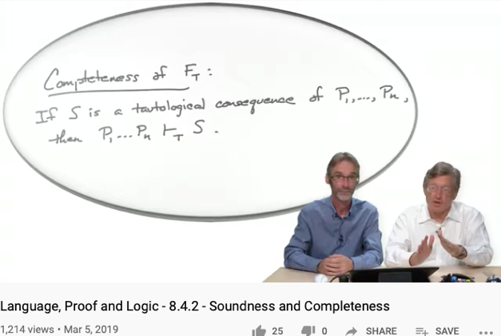
Soundness
Completeness
For engineering/scientific purpose, it is difficult to escape Monism
The unifying notion of “Truth” is the source of Monism
Every provable statement is true
Every true statement is provable
Cited from : Soundness and Completeness: With Precision on news.ycombinator.com
https://youtu.be/3hspKYIn5ds?t=29
https://youtu.be/3hspKYIn5ds?t=162

Slide 39
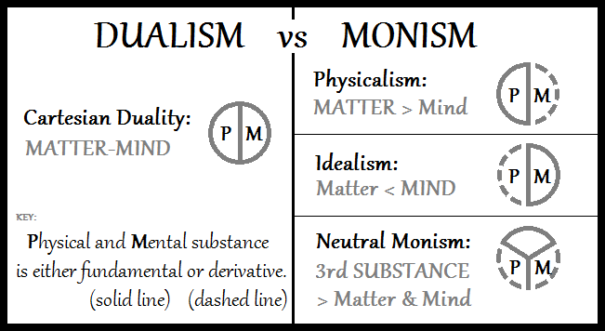
From Monism, Dualism to Cyber-physical Systems
Image Source: Double-aspect Theory on Wikipedia

Slide 40

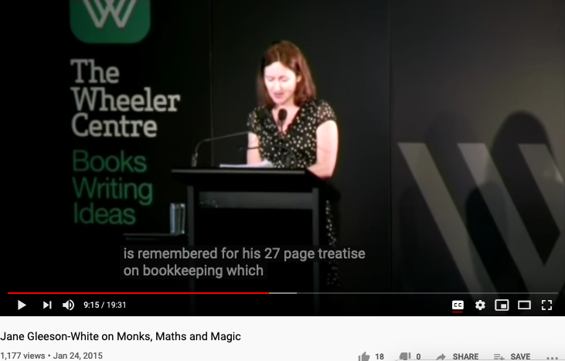
Double Entry, Monks, Maths, and Magic

Slide 41
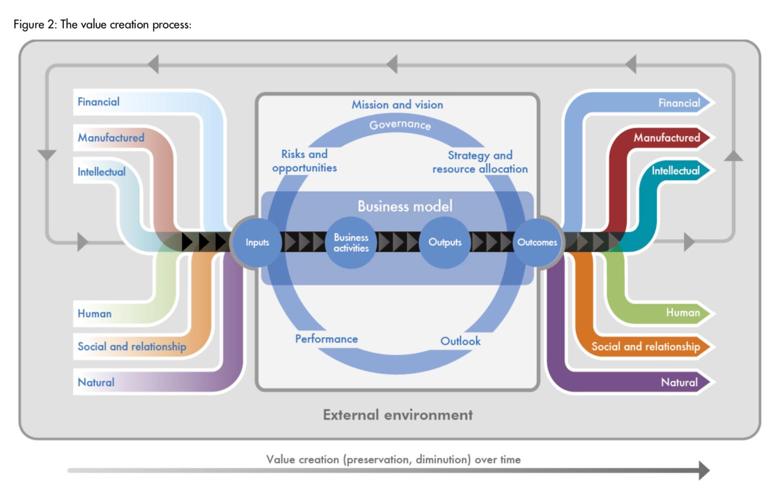

Accountants’ Value Proposition
The International
Integrated Reporting
Framework
Dec. 2013
Notes:
“historian James Aho linked double-entry bookkeeping to the ancient art of rhetoric,”
Excerpt From: Jane Gleeson-White. “Double Entry.” Apple Books.

Slide 42
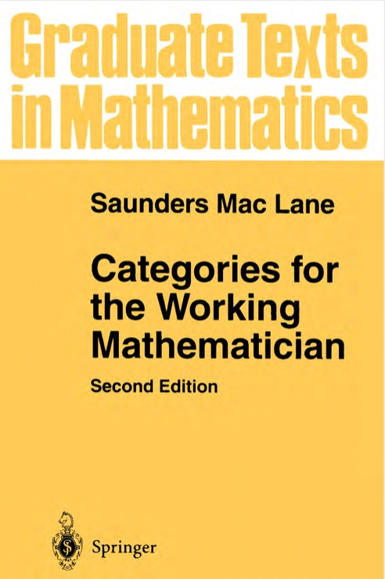
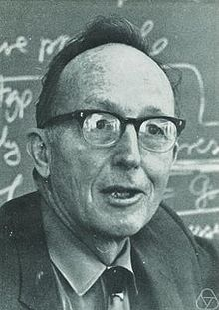
Saunders Mac Lane: Founder of Category Theory
Categories, Functors and Natural Transformation.
Constructions on Categories.
Universals and Limits.
Adjoints.
Limits.
Monads and Algebras.
Monoids.
Abelian Categories.
Special Limits.
Kan Extensions.
Symmetry and Braiding in Monoidal Categories.
Structures in Categories.
Tables of Categories. Bibliography.
Saunders Mac Lane (Wikipedia)

Slide 43
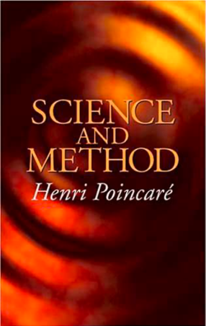

It is all in the Names

Slide 44
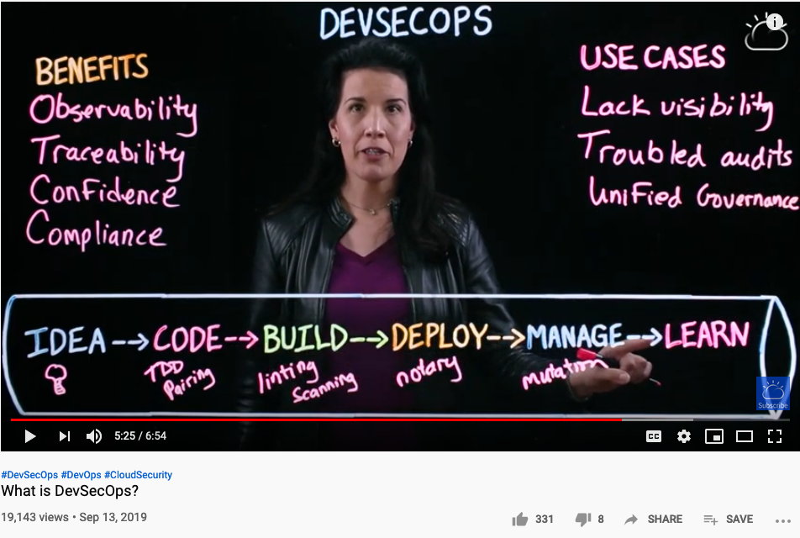
Cybernetics is governing our Cognitive Foundation

Slide 45
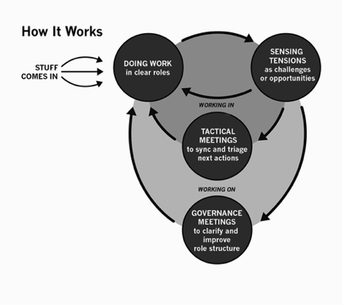

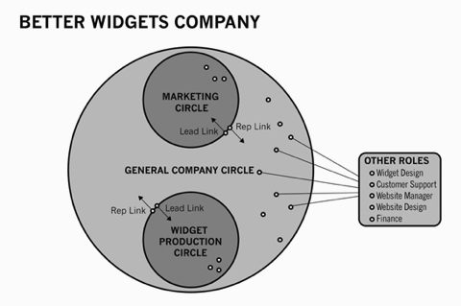
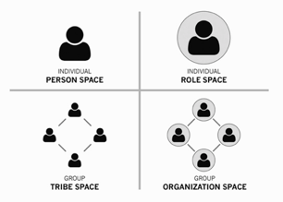
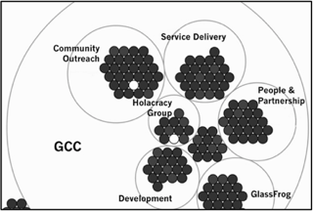
Holacracy: a mechanism for Communication and Control
Holacracy applied Recursively
Image Source: Holacracy: The New Management System for a Rapidly Changing World

Slide 46

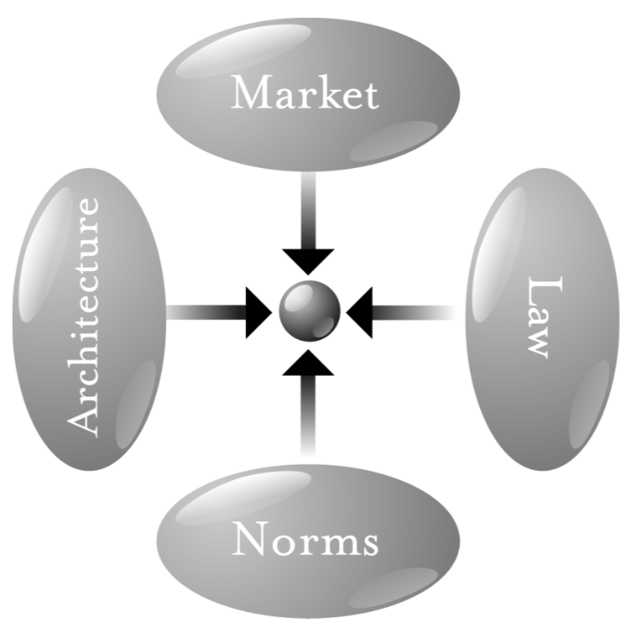

The arrow diagram in Cyberspace
市场
Far
Space
Near
架构
执法
Before Time After
常态
Image Source: page 123 of Code V2 by L. Lessig
Notes:
我们这一套体系最基础的模型就是基于芝加哥学派所划出的产业发展四力模型而出的。

Slide 47

The version that includes modern cybernetic tools
Far
Space
near
before Time after

Slide 48


Kan Extension helps achieve Soundness and Completeness
Huawei VP Mr. Yang Shaoqing
All these terms are equivalent…
they can be refomulated into each other…

Slide 49
Conclusion/Summary
A cognitive foundation based on Unitary Computing System:
Easier to find isomorphism due to the compact Name Space
Kan Extension refers to Adjoint Function/Galois Connection/Approximation
Mathematical ideas named after human names shows that we are still belief in human
Cybernetics is being realized with tools such as Kubernetes:
Many people can operate large scale named objects from distributed locations.
A different model of governance/magic is lurking…

